Slide 1
DATA SCIENCE USING PYTHON
GUIDE : E.RAMESH FARHAAN – Y21CS102

Slide 2
Step 1
INTRODUCTION
LITERATURE SURVEY
Limitations of old systems
Current Systems Advantages
Step 2
Step 3
MODULES & DESIGN
Step 4
IMPLEMENTATION & CONCLUSION

Slide 3
INTRODUCTION
Welcome! From past 10-15 years most of the people are communicating through SMS, Mails … As we all know that we are getting some unwanted SMS which are not important and not subscribed these are generally called as Spam messages in particular, can be annoying, and in some cases, even harmful. SMS Spam Classification classifies whether the SMS is spam or not

Slide 4
We have an another issue that is Hate Speech , Language Violation, we all are facing in social media . Hate speech is any form of communication that attacks a person or group on the basis of attributes such as race, religion, ethnicity, sexual orientation, or gender . Hate speech Detection detects the message or tweet .… which have hate speech. The loan providing companies find it hard to give loans to the people due to their insufficient or non-existent credit history. Because of that, some consumers use it as their advantage by becoming a defaulter. EDA is a tool that lending companies can use to uncover insights from their data, enabling them to make more accurate assessments of an applicant's creditworthiness. This, in turn, helps mitigate the risk of approving loans to individuals who may default while ensuring that deserving applicants are not unfairly rejected based solely on limited credit history information..

Slide 5
LITERATURE SURVEY

Slide 6
LIMITATIONS OF OLD SYSTEMS: SMS Spam Classification Traditional rule-based spam filters often rely on a limited set of rules, making them susceptible to evasion by spammers. Real-time spam detection systems can be computationally expensive and may not scale well with increasing message volumes. Hate Speech Detection Traditional keyword-based approaches may fail to identify hate speech that employs subtle or nuanced language. Hate speech detection systems can be overzealous, flagging legitimate speech as offensive.

Slide 7
Credit EDA :
Traditional fraud detection methods often rely on static rules or thresholds, making them less effective in detecting evolving fraudulent patterns.
Manual analysis of credit card transaction data can be time-consuming and error-prone.
Existing fraud detection systems may not be able to adapt to changes in transaction patterns or emerging fraud schemes.

Slide 8
CURRENT SYSTEM ADVANTAGES : Adaptability: Data science models can be continuously updated with new data and insights, enabling them to adapt to changing patterns and trends. Scalability: Data science models can be efficiently scaled to handle large volumes of data, making them suitable for real-time applications. Accuracy: Data science models can achieve high levels of accuracy, minimizing misclassifications and false positives. Unbiasedness: Data science models can be trained on carefully curated datasets to mitigate biases and ensure fair detection.

Slide 9
MODULES

Slide 10
Preprocessing
Libraries: Pandas, NLTK (Natural Language Toolkit)
Techniques: Cleaning, normalization, tokenization, stemming, lemmatization
Feature Extraction
Libraries: scikit-learn, spaCy
Techniques: N-grams, TF-IDF (Term Frequency-Inverse Document Frequency), word embedding
SMS Spam
Classification
Model Selection
Evaluation
This involves selecting and training a machine learning model to classify SMS messages as spam or not spam.
Libraries like scikit-learn, TensorFlow, and PyTorch
The model's performance is evaluated using metrics like accuracy, precision, and recall.
Libraries like Flask, Django, and Streamlit

Slide 11
Libraries: Pandas, NLTK
Techniques: Cleaning, normalization, tokenization, stemming, lemmatization, removing irrelevant content
Preprocessing
Feature Extraction
Libraries: spaCy, Gensim
Techniques: N-grams, sentiment analysis scores, word embedding, part-of-speech (POS) tagging
Hate Speech
Detection
The model's performance is evaluated using metrics like accuracy, precision, and recall.
Libraries like Flask, Django, and Streamlit
Model Selection
Evaluation
This involves selecting and training a machine learning model capable of identifying hate speech in SMS messages.
Libraries like scikit-learn, TensorFlow, and PyTorch

Slide 12
Libraries: Pandas, NumPy
Techniques: Handling missing values, detecting outliers, transforming categorical variables
Preprocessing
Exploratory Data Analysis
Libraries: Pandas, Matplotlib, Seaborn
Techniques: Descriptive statistics, data visualization, univariate analysis, bivariate analysis
Credit
EDA
Libraries: Pandas, Matplotlib, Seaborn
Techniques: Data visualization, generating reports, communicating findings to stakeholders
Fraud Identification
Reporting and Actionable Insights
Libraries: scikit-learn, TensorFlow, PyTorch
Techniques: Clustering algorithms, anomaly detection algorithms, machine learning models

Slide 13
DESIGN

Slide 14
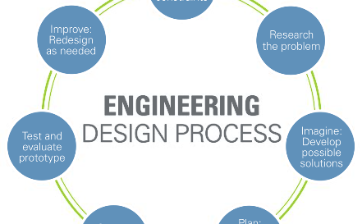
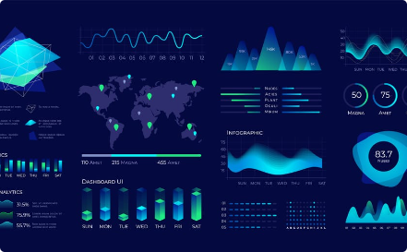
PROBLEM ANALYSIS
Thoroughly analyze the problem statement and define the objectives.
VISUALIZATION
Present your insights through compelling visualizations for effective communication.

Slide 15

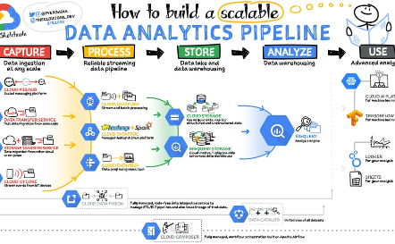
Architecture Design
Create a robust and scalable architecture for your data science project.
DATA PIPELINE
Design an efficient data pipeline to streamline the flow of data through various stages.

Slide 16
IMPLEMENTATION

Slide 17
1
Data Acquisition
Gather relevant data from various sources.
2
Data Preprocessing
Clean, transform, and format the data to make it suitable for analysis.
3
Model Development
Build and optimize machine learning models.

Slide 18
4
Evaluation & fine-tuning
Evaluate model performance, fine-tune parameters, and validate the results.
5
DEPLOYMENT
Deploy the final model into production.

Slide 19
CONCLUSION

Slide 20
In conclusion, this presentation has provided an overview of data science using Python projects. We explored the introduction, literature survey, modules, design, implementation, and the significance of each component in this exciting field. Now, it's time to unlock your potential in data science!

